Slide 1
Designing Criminological Research
Tuesday 27th September 2016

Slide 3
Aims of this course
Understand the nature of social (criminological) research
Formulate original research questions
Select suitable research designs
Develop dissertation ideas
Critically engage with high level methodology
Gain more from the reading

Slide 4
Format of this course
6 x lectures
Core reading/ watching before lecture
Lecture as overview of concepts
Do exercises
2 x practical sessions
Developing your ideas
Troubleshooting workshop

Slide 5
Assessment
Research proposal (ideally for your dissertation)
3,500 words
Review of literature (will cover methods in course)
Project proposal
Secondary data analysis

Slide 6
Assessment
A typical proposal includes
a clearly thought out research question,
(brief) literature review
hypotheses, and well-articulated concepts.
the research design (data collection and analyses),
issues around data quality and
ethical issues.

Slide 7
Why do research?
????

Slide 8
Why do research?

Slide 9
Why do research? – Curiosity
For example,
Vaughn, M. S., Del Carmen, R. V., Perfecto, M., & Charand, K. X. (2004). Journals in criminal justice and criminology: An updated and expanded guide for authors. Journal of Criminal Justice Education, 15(1), 61-192.
is a descriptive paper that summarizes the mission, philosophy, and editorial policies of a selection of journals in criminal justice and criminology.

Slide 10
Why do research?

Slide 11
Why do research? – Social problems
For example,
Research into the use of sobriety checkpoints shows that they help to reduce alcohol related injuries and crashes.
(see: http://whatworks.college.police.uk/toolkit/Pages/Intervention.aspx?InterventionID=7)
Notes:
Review 1: Erke A., Goldenbeld C. & Vaa T.: (2009), The effects of drink-driving checkpoints on crashes – A meta-analysis, Accident Analysis and Prevention, 41: 5; 914-923
Review 2: Bergen G., Pitan A., Qu S., Shults R., Chattopadhyay S., Elder R., Sleet D., Coleman H., Compton R., Nichols J., Clymer J., Calvert W., and CPSTF: (2014), Publicized Sobriety Checkpoint Programmes: A Community Guide Systematic Review, American Journal of Preventive Medicine, 46:5; 529-539​
Review 3: Elder R., Shults R., Sleet D., Nichols J., Zaza S. & Thompson R.: (2002), Effectiveness of Sobriety Checkpoints for Reducing Alcohol-Involved Crashes, Traffic Injury Prevention, 3:4; 266-274

Slide 12
Why do research?

Slide 13
Why do research? – Theory Testing
For example,
Farrell, G. (2013). Five tests for a theory of the crime drop. Crime Science, 2(1), 1.
Uses research to test hypotheses about what is causing the crime drop.

Slide 14
How can we approach research?
????

Slide 15
How to approach research?
Paradigms
Dictate what and how to research
‘Normal’ science
Overturned by paradigm shift
Further reading: Kuhn, T. S. (2012). The structure of scientific revolutions. University of Chicago press. ﻿Chicago
Notes:
Paradigm: an analytic lens, a way of viewing the world and a framework from which to understand the human experience (Kuhn, 1962).

Slide 16
What is research?
????

Slide 17
What is research?
“Process of enquiry and discovery achieved by generating and analyzing evidence, evaluating and interpreting findings, and drawing robust conclusions”
(Kitchin & Tate, 2000)

Slide 18
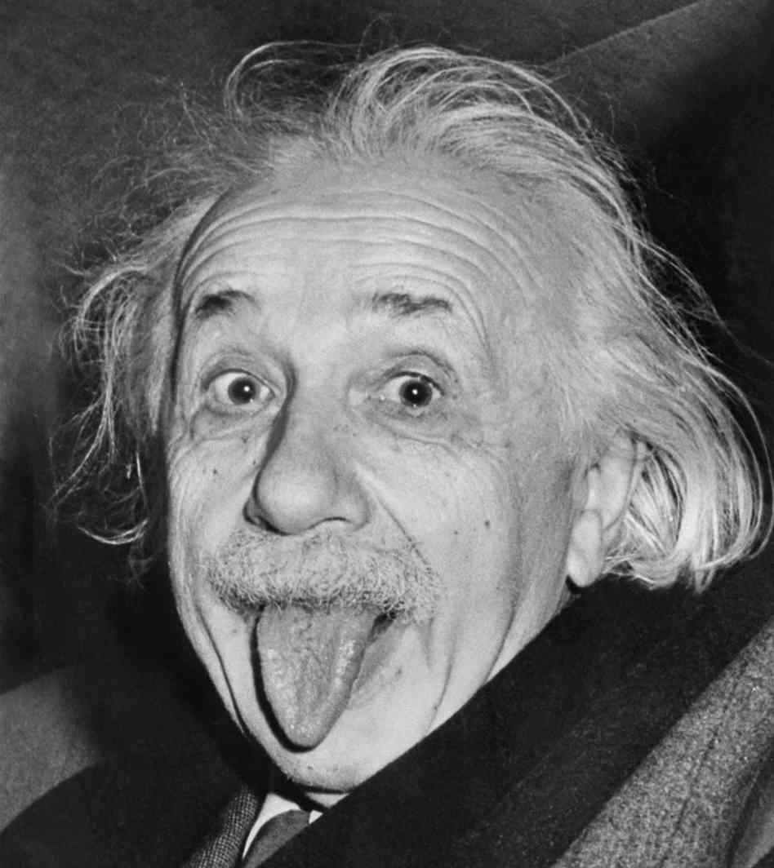
What is research?
“Process of enquiry and discovery achieved by generating and analyzing evidence, evaluating and interpreting findings, and drawing robust conclusions”
(Kitchin & Tate, 2000)
“If we knew what it was we were doing, it would not be called research, would it?”

Slide 19
What is research?
“Process of enquiry and discovery achieved by generating and analyzing evidence, evaluating and interpreting findings, and drawing robust conclusions”
(Kitchin & Tate, 2000)
““If we knew what it was we were doing, it would not be called research, would it?”
“What is research, but a blind date with knowledge.”
William Harvey

Slide 20
What is research?
“Process of enquiry and discovery achieved by generating and analyzing evidence, evaluating and interpreting findings, and drawing robust conclusions”
(Kitchin & Tate, 2000)
““If we knew what it was we were doing, it would not be called research, would it?”
????
“What is research, but a blind date with knowledge.”
William Harvey

Slide 21
What is research?
Research is the conscientious study of an issue, problem, or subject (Dantzker, 2006)

Slide 22
What makes research scientific?
Good research, be it qualitative or quantitative, must follow four principles in design
Goal is inference
Procedures are public
Conclusions are uncertain
Content is the method
(King et al 1994)
Notes:
King, G., Keohane, R. O., & Verba, S. (1994). Designing social inquiry: Scientific inference in qualitative research. Princeton university press.

Slide 23
Goal is inference
Make descriptive or explanatory inferences
Based on empirical information
Descriptive inference
Using observations to learn about other unobserved facts
Causal inference
Learning about causal effects from data

Slide 24
Procedures are public
Methods for collecting and analysing data are
explicit,
codified, and
public
Method and logic for inferences must be explicit
Reliability can be assessed

Slide 25
Conclusions are uncertain
Data is uncertain so conclusions can’t be certain
Need to address uncertainty
Discuss limitations of knowledge and insight

Slide 26
Content is the method
The “science” part is the method & rules, not subject matter
Adhere to a set of rules for inference
But topic can be anything

Slide 27
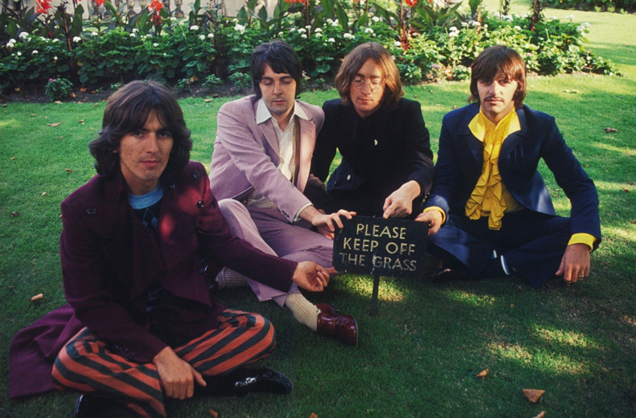

Slide 28
Levels of inquiry
Macro
Meso
Micro

Slide 29
Levels of inquiry
Global
Systemic
Domestic
Individual

Slide 30
Levels of inquiry
Systemic
Ecological
Individual

Slide 31
Micro examples?
Street segment
Within-day fluctuation
Individual actors/ decision makers

Slide 32
Meso examples?
Neighbourhood
Schools
Community groups

Slide 33
Macro examples?
National and international trends
Change over years
Interaction of large systems

Slide 34
How to do research?
????

Slide 35
Theory
Research Q
Concepts
Hypotheses
Methods
Data
>
>
>
>
Deductive
>
>
>
>
>
>
Inductive
Support for hypothesis (or not)
>
>
>
Notes:
What does it mean to think about questions in a systematic way? Just means you take a structured approach. You can adopt various frameworks, and I will talk about different frameworks in a bit, but first let’s look at an overview of the research process from a systematic approach. Normally, in academic research you start out with a theory, however in industry this is often an issue or problem given to you by stakeholders. Does anyone have an example? *use example* If not then we’re going with a theory. Okay so my theory is that segregated cycle lanes are good. If my theory is correct, then I will recommend building more segregated cycle lanes. If it is not correct then this may be a waste of resources, and cause unnecessary trouble. So I need to find out if my theory is correct or not. To do this, I will have to break this theory into basic concepts. To do this we need to identify the important variables, and break the question down into simple, measurable concepts. So for example how would I turn the theory of segregated cycle lanes are good into measurable elements. I can think about how I would measure the good-ness. Let’s say that the aim is to increase people who cycle to work, then these lanes are good if they increase the number of new cyclists on the road. So then from this I formulate my hypothesis, which is a testable statement. So the hypothesis here is: “segregated cycle lanes increase the number of new cyclists who commute to work”. So the aim of research then is to examine the validity of this hypothesis. Is it true? To examine this we need to collect data, and then analyse and interpret this data in order to make conclusions. How would you collect data for this? Set up a study// questionnaire// many ways. This stage is the one that you have to focus on a lot, and where you must be sure that you are asking the correct questions, in order to be able to produce answers. Anyway once you have analysed your data you can either accept or reject your hypothesis, and on the basis of that make new theories and ask new questions. So there are various approaches you can take to this.

Slide 36
Theory
Conceptual basis for understanding, analyzing, and designing ways to investigate relationships within social systems.
Predicts events in a broad, general context
Usually extensively tested and is generally accepted among scholars
Notes:
Adapted from: Torraco, R. J. “Theory-Building Research Methods.” In Swanson R. A. and E. F. Holton III , editors. Human Resource Development Handbook: Linking Research and Practice. (San Francisco, CA: Berrett-Koehler, 1997): pp. 114-137; Jacard, James and Jacob Jacoby. Theory Construction and Model-Building Skills: A Practical Guide for Social Scientists. New York: Guilford, 2010; Sutton, Robert I. and Barry M. Staw. “What Theory is Not.” Administrative Science Quarterly 40 (September 1995): 371-384.
Cherry, Kendra. Introduction to Research Methods: Theory and Hypothesis. About.com Psychology; Gezae, Michael et al. Welcome Presentation on Hypothesis. Slideshare presentation.

Slide 37
Theories?
Eg: Crime pattern theory
(see Brantingham, P., & Brantingham, P. (2008). 5. Crime pattern theory. Environmental criminology and crime analysis, 78. )

Slide 38
Research Question
A question that is “researchable” (or “investigateable”)
Doesn’t necessarily require collection of new evidence – can ask Q from existing literature that challenges it in some way
More on research Q later…
Notes:
Alvesson, M., & Sandberg, J. (2013). Constructing research questions: Doing interesting research. Sage.
Chicago

Slide 39
Research Questions?
Eg: What is the effect of limited awareness space on juvenile offenders?

Slide 40
Concepts
Labels that scholars need to communicate
What you need to measure to answer Qs
Joined to theories
Concept formation comes before measurement
Establish what is of interest and what is not
If theory ambiguous, might grow concepts from empirical material eg: with grounded theory

Slide 41
Concepts?
Eg: Awareness Space
Offender
Youth

Slide 42
Hypothesis
A specific, testable prediction about what you expect to happen in your study
A specific prediction about a specified set of circumstances
A speculative guess that has yet to be tested

Slide 43
Hypothesis?
Eg:
Juveniles have smaller activity space than adults
Juveniles will offend closer to home than adults

Slide 44
Methods
different ways of generating and analyzing data about that social world
Notes:
Reynolds, R. Larry. Ways of Knowing. Alternative Microeconomics. Part 1, Chapter 3. Boise State University; The Theory-Method Relationship. S-Cool Revision. United Kingdom.

Slide 45
Methods?
Eg:
Quantitative:
Analysis of Crime Statistics
Qualitative:
Focus groups

Slide 46
Inductive v Deductive
Deductive approach: start with theory, test with data
Inductive approach: generation of new theory emerging from the data

Slide 47
Inductive v. Deductive?
Finds clues
Draws conclusions
Creates theories

Slide 48
Inductive v. Deductive?
Inductive !!!

Slide 49
Inductive v. Deductive?
Thinks Neo is the one
Subjects him to tests
Draws conclusions

Slide 50
Deductive !!!

Slide 51
Homework
Browse through past ESRC funded research (http://researchcatalogue.esrc.ac.uk/search/search-page.aspx?q=crime)
Select one and look for:
Level of inquiry
Theory
Hypothesis
Method proposed
Inductive or deductive

